Slide 1
Ebay watch price analysis

Slide 2
Introduction
This project focuses on building an end-to-end data science pipeline using real-world e-commerce data. The dataset was collected through web scraping from an online marketplace and contains product-level information related to watches. The objective of this project is to extract meaningful insights from raw data, apply machine learning techniques, evaluate model performance, and present business-friendly visualizations.

Slide 3
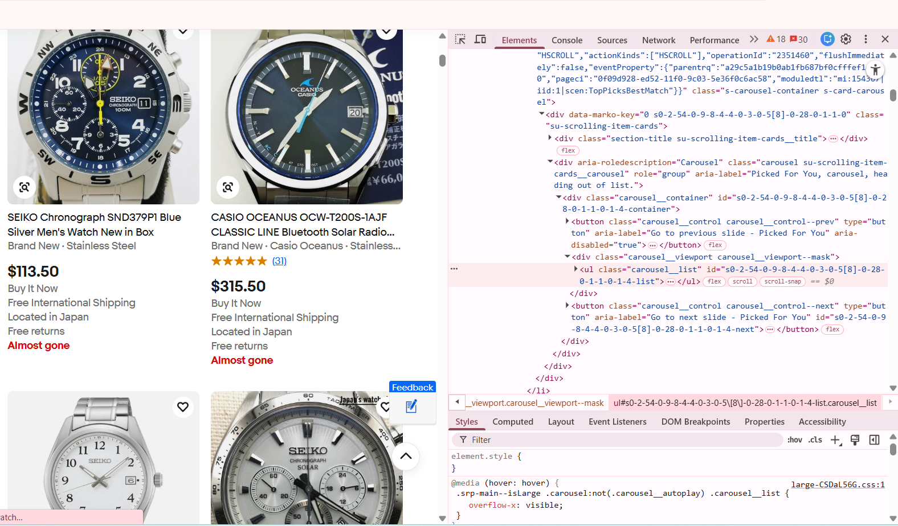
Web Scraping Using Python
The data for this project was collected through web scraping using Python. Web scraping involves programmatically extracting data from websites by sending HTTP requests and parsing the returned HTML content. Python libraries such as Requests and BeautifulSoup were used to access web pages and identify relevant HTML elements containing product information. The collected data was then converted into a structured format using Pandas and stored as a dataset for further analysis. This step ensured the availability of real-time and relevant data for the project.

Slide 4
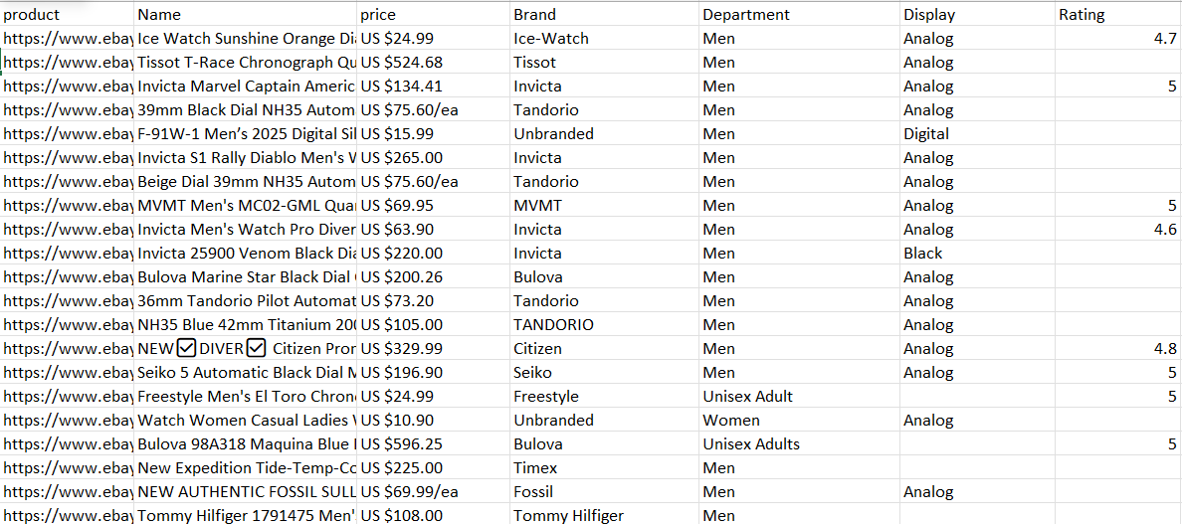

Slide 5

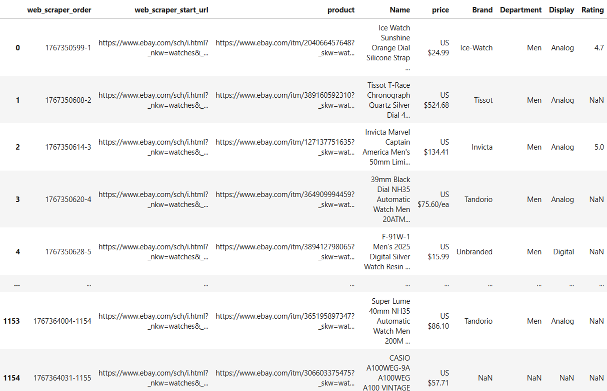
dataset
The dataset consists of structured product-level information obtained from the web scraping process. It contains attributes such as product name, brand, department, display type, and price. The dataset includes both categorical and numerical variables, reflecting typical challenges of real-world data such as missing values and inconsistent formats. Data cleaning and preprocessing were performed to standardize column names, handle missing values, and convert price data into numerical format. The final dataset was prepared to support both exploratory analysis and machine learning tasks.

Slide 6
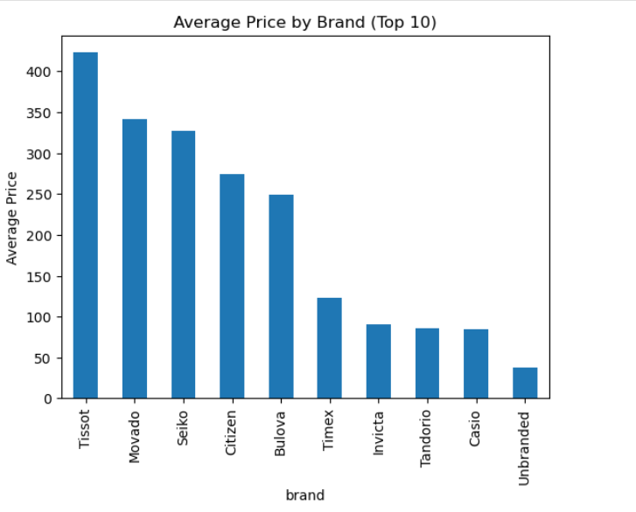
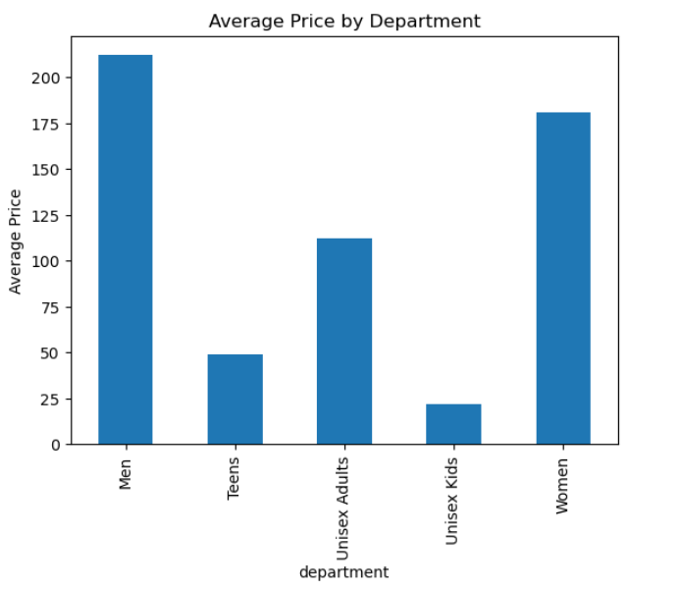
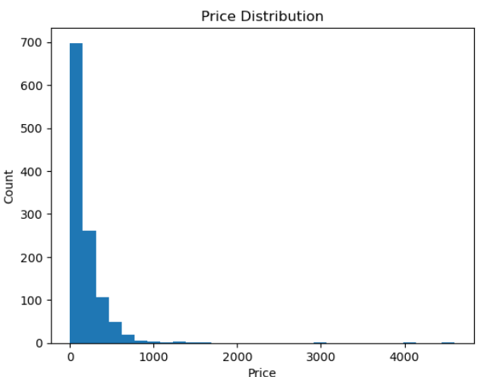
Exploratory Data Analysis (EDA)

Slide 7
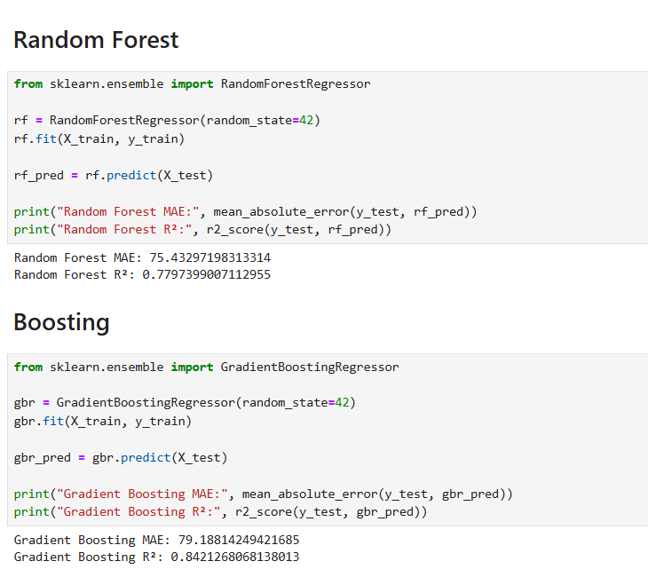
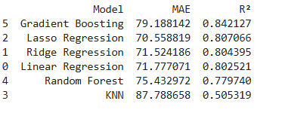
Supervised Learning
Supervised learning techniques were applied to predict the price category of watches based on their attributes. The target variable was created by categorizing product prices into low, medium, and high ranges. Categorical features such as brand, department, display type, and product name were encoded using suitable encoding techniques, while numerical features were scaled as required. Multiple classification models were trained, including Logistic Regression, Random Forest, Gradient Boosting, and K-Nearest Neighbors.

Slide 8
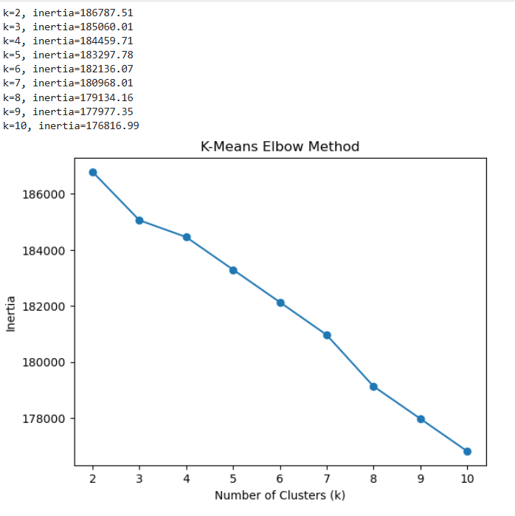
Unsupervised Learning
Supervised learning techniques were applied to predict the price category of watches based on their attributes. The target variable was created by categorizing product prices into low, medium, and high ranges. Categorical features such as brand, department, display type, and product name were encoded using suitable encoding techniques, while numerical features were scaled as required. Multiple classification models were trained, including Logistic Regression, Random Forest, Gradient Boosting, and K-Nearest Neighbors. These models learned patterns from labeled data and attempted to classify products into the appropriate price category.

Slide 9

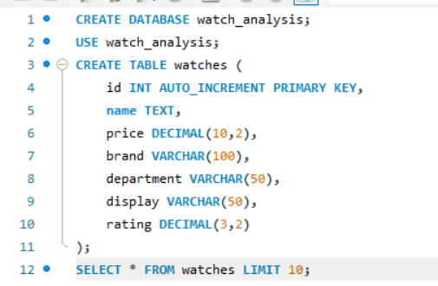
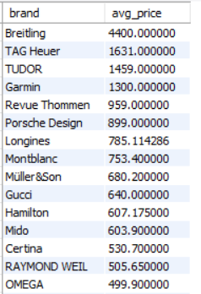
SQL connection
After preprocessing and analysis, the dataset was stored in a MySQL database to enable structured data storage and efficient querying. Python was used to establish a connection with the database using sql and the cleaned dataset was inserted into a relational table. SQL queries were executed to retrieve meaningful insights such as highest priced products and brand-wise analysis. This step demonstrated the integration of data science workflows with database management systems.

Slide 10
Power BI
Power BI was used to create an interactive dashboard for visualizing key insights from the dataset. The MySQL database was connected directly to Power BI to enable dynamic data loading. Visualizations such as price distribution, brand comparison, and department-wise analysis were created to support business decision-making. DAX measures were used to calculate metrics like the highest priced product and its corresponding name. The dashboard provides an intuitive interface for stakeholders to explore the data.

Slide 11
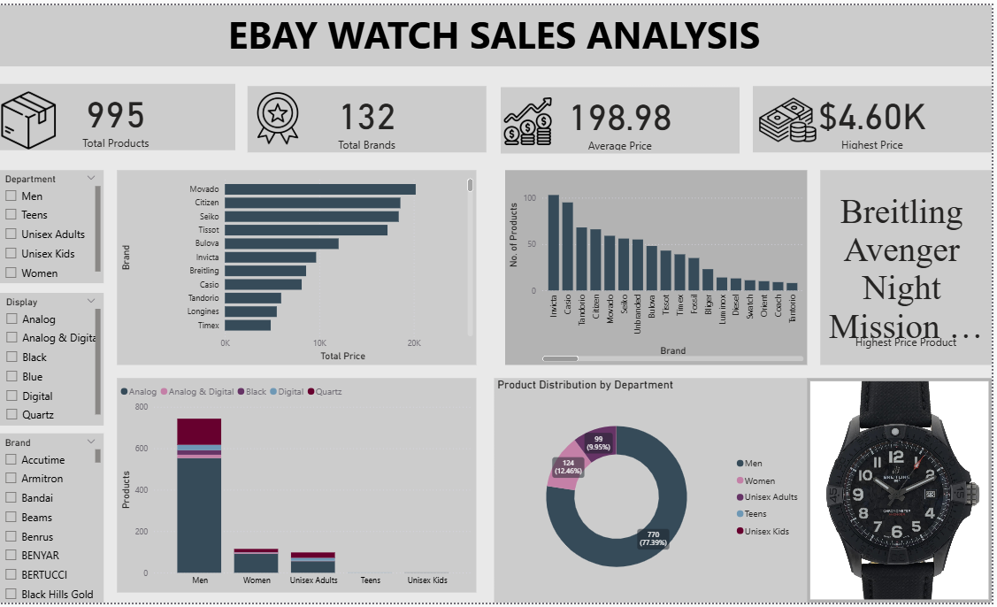

Slide 12
Conclusion
This project successfully demonstrates the implementation of an end-to-end data science pipeline using real-world e-commerce data. From web scraping and data preprocessing to machine learning, database integration, and visualization, each stage was executed systematically. The project highlights the importance of data-driven analysis in understanding market trends and supports the application of machine learning models for predictive insights. Overall, the project reflects practical skills and methodologies required for real-world data science applications.

Slide 13
Thank you

